Slide 1
Practice and legislation on Transfer Pricing in Dominican Republic
Wanda M. Montero
Oslo, Norway

Slide 2
Outline
Some Tourism Industry Facts
Some All Inclusive Hotels Facts
Legal Framework
Sector Audits Strategy
Tax Base
Procedure
Results
Future of Transfer Pricing

Slide 3
Source of Capital MNEs

Slide 4
Sector Audits

Slide 5
Tourism Industry Facts
Dominican Republic is the 4th Tourism exporter in Latin America and the Caribbean (Surpassed by Brazil, Mexico and Argentina)
The Foreign Direct Investment is around 1/4 of the total FDI
As a percentage of the GDP, the tourism industry represent about 10% of the GDP

Slide 6
Tourism Industry Facts
Tourism Value Added as a percentage of GDP

Slide 7
All Inclusive Hotels Facts
93% of companies its capital comes from foreign investments
Tax incentives regime (Import IVA, Local taxes, IVA, etc)
At least 80% of the hotel room are sell to a related party located in a tax heaven.
The unit income (per room price) lower than the unit cost.
Per room rate lower than the one published in many booking webpage and Tour Operator catalog.

Slide 8
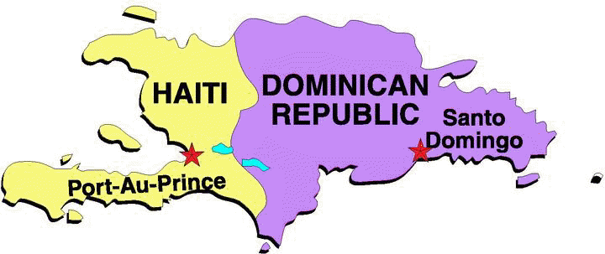
All Inclusive Hotels: The Business

Slide 9
Legal Framework
1992
2012
Arm’s Length Principle
Related Party definition
Comparability Analysis Criteria
Methods
Adjustment to comparable transaction
APA
Safe Harbours
Documentation
Others
2006
Faculty of the Tax Administration
APA’s
Interest payed and cost distributed between related parties
Notes:
The ALP was introduced in the Dominican Republic legislation in 1992, but it didn’t explain or give any guidelines of how can be implemented. Further legislation in 2006 offered more support to the ALP implementation. By a secondary legislation in 2011, the specific guidelines to implement and the obligation by tax payers was introduced.
The ALP states:
"Legal acts concluded between a local company with foreign capital and a natural person or legal entity domiciled abroad, that directly or indirectly controls it, will be considered, in principle, to be done between independent parties when the provisions are consistent with normal market practices between independent entities ... "

Slide 10
Legal Framework
“In the case of the hotel sector of all inclusive, whose business has particular links with related parties overseas, the Tax Administration may define advance pricing agreements (APA) about the prices or rates that will be recognized on the basis of parameters of comparability by areas, analysis of costs and other variables of impact in the hotel business in all inclusive.
For the signing of the APA, the sector will be represented by the National Association of Hotels and Restaurants (ASONAHORES).
The agreements will be published by resolution and its validity shall be 18 months. The subsequent agreements may have a duration of up to 36 months.
In cases that an Advance Pricing Agreement have expired, and there is not a new agreement, the previous agreement hall continue in force until approved the new APA…”
Notes:
The amendment to Article 281 in 2006, by Law 495-06, introduced elements that were necessary for the determination and evaluation of transfer pricing between related companies; Also focused in developing a method to audit the Hotel industry, because this industry reported looses in their financial statements

Slide 11
Legal Framework
Determination Ex–oficio
Tax Code allow to discard the Affidavits that did not deserve faith, because are not reliable or accurate, and in turn, empower the Tax Administration, in such cases, proceed to determine the tax obligation, even though the taxpayer has an organized accounting with books and accounting records up to date.
Notes:
The Dominican legislation also contained provisions on the economic reality of transactions (substance over form); assessments of income from exports and imports; as well as the ability to estimate ex officio, the taxable income based on averages, coefficients and other indexes, which complement the transfer pricing regulations.

Slide 12
Sector Audit Strategy
Tax Base: based on the hotel rate at which the guest or final consumer overseas pay per night;

Slide 13
Sector Audit Strategy
Procedure:
Find the Per night rate pay by tourist oversea, in a 7 nights packages, discounting the transportation.
The rates were segmented according to the category of the hotel, location and season
5 categories were identified in each zone. ASONAHORES submitted these categories.
2 Seasons were identified, high and low season.
3 different region, A, B, and C. A for the expensive one, C for the cheapest.

Slide 14
Sector Audit Strategy
Procedure:
10% of mandatory Tip and 16% of IVA was discounted.
The margin of 20 and 25%, as a markup was discounted. This margin is it supposed to be the profit margin the tourism intermediaries get for the commercialization service.

Slide 15
Sector Audit Strategy
Results:
Audits by fiscal year
2005-2010
Fiscal period audited
2005-2010
Tax Period | Quantity
2005 | 1
2006 | 1
2007 | 16
2008 | 3
2009 | 32
2010 | 20
Total | 73
Audited Periods | Taxpayers
1 period | 5
2 periods | 14
3 periods | 12
4 periods | 1
Total | 33

Slide 16
Sector Audits Strategy
Results:
Judgments from the Supreme Administrative Court, sustains and confirms the action as legal and correct, in both form and substance, and therefore, confirming the amounts of the estimates contained in the resolutions of determination of tax.

Slide 17
Future of TP
Around 70% of the audited hotels agreed to rectify their Tax Returns for the period 2007-2010 and 2011 in few cases
Since last year, taxpayers began to submit their Transfer Pricing documentation for the 2011 fiscal period.
Further Modifications were introduced to the Tax Law this month, eliminating the Sector APA’s, instead were included the unilateral and bilateral APA’s and Safe Harbours.

Slide 18
Thank You!

